Slide 1
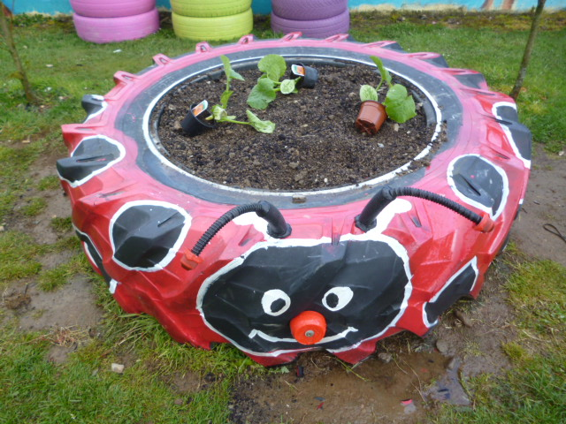
The school garden
DIGGING INTO THE RESEARCH
Paddy Madden

Slide 2
GENERAL
The research …….illustrates how teaching and learning in the school garden can make a valuable contribution to children’s social, academic and emotional development, and how the sheer pleasure of creating a garden can have a ripple effect throughout the school, as others enjoy the beauty and/or the produce that result from this effort. The research also shows how using the school garden as an arena for learning is hampered by national policy that, on the one hand, recommends learning outside as an experience that deepens and enriches learning inside the classroom (DfES 2006; Ofsted 2008) but, on the other, fails to promote an environment in which teachers can have the freedom and confidence to experiment with different approaches without fear of external recrimination. (Passey, R. (2014), p.26)

Slide 3
PRESSURE!

Slide 4
In addition, the research draws attention to some of the potential casualties of a high-pressure, high-stakes performativity agenda in which practitioners align their teaching to targets, indicators and evaluations (Ball 2003) – those children and young people who, for a host of different reasons, are struggling with classroom learning. The reported benefits of the school garden included the capacity to offer respite from the intensity of the classroom environment and a sense of enjoyment and success that had been lacking in some pupils’ school experience ( Passey, R. 2014, p.36)
Passy, R. (2014). School gardens: teaching and learning outside the front door. Education 3-13: International Journal of Primary, Elementary and Early Years Education, 42 (1),23-38, DOI: 10.1080/03004279.2011.636371

Slide 5
TEACHING TO THE TARGETS

Slide 6
SCIENCE;MATHS;LITERACY;ORACY (COGNITIVE LEARNING)
They increase science achievement scores etc.
They [teachers]identified cases in which, through garden-related activities, children were able to demonstrate an understanding of scientific concepts (such as taxonomy), scientific methods (including devising experiments), scientific knowledge (including habitats and life-cycles) and appropriate scientific language. The range of strategies teachers used were broader than was possible in a classroom and involved children moving about, touching, feeling, exploring and observing for themselves. (Passey et al 2010, p.20),
Passy, R, Morris, M, and Reed, F. (2010). Impact of school gardening on learning: Final report submitted to the Royal Horticultural Society.
Klemmer, C. D., T. M. Waliczek, and J. M. Zajicek. 2005. Growing minds: The effect of a school gardening program on the science achievement of elementary students. HortTechnology15(3):448-452

Slide 7
GARDENING BRING CONCEPTS TO LIFE

Slide 8
BEHAVIOUR (BEHAVIOURAL AND PHYSICAL LEARNING)
They have a positive influence on behaviour and achievement. Behaviour towards food, others; gross and fine motor skill development.
Improved confidence and self-esteem was also seen as an outcome of being able to contribute (and being seen to be able to contribute), through the garden, to the school and wider community. This was demonstrated in a number of different ways. As a result of the public celebration of their garden work in assembly, some previously disruptive pupils were said to feel better about themselves and to have become less unruly. (Passey et al 2010, p.23)
Passy, M, Morris, M, and Reed, F. (2010). Impact of school gardening on learning: Final report submitted to the Royal Horticultural Society
Blair, D. (2009). The child in the garden: an evaluative review of the benefits of school gardening. Journal of Environmental Education 40(2), 15-38.
DeMarco, L., P. D. Relf, and A. McDaniel. 1999. Integrating gardening into the elementary school curriculum. HortTechnology 9(2):276-281.

Slide 9
BEHAVIOUR CAN IMPROVE

Slide 10
APPRECIATION OF NATURE (AFFECTIVE LEARNING)
They develop a respect for nature that lasts into adulthood. Also resilience, self-esteem, sense of calmness, enjoyment of the outdoors.
Having a garden has made us happier because we’re not always in the classroom. It’s made the teachers happier as well ... When you’re out there you feel like you won’t get told off if you say something. In the classroom you might be scared to say something in case it was silly. (Passey et al 2010, p.24)
Lohr, V.I. and C.H. Pearson-Mims. 2005. Children’s active and passive interactions with plants influence their attitudes and actions toward trees and gardening as adults. HortTechnology.15(3): 472-476.
Passy, M, Morris, M, and Reed, F. (2010). Impact of school gardening on learning: Final report submitted to the Royal Horticultural Society.

Slide 11
A LASTING GIFT

Slide 12
SOCIAL SKILLS( INTERPERSONAL AND SOCIAL LEARNING)
The garden fosters friendships among children and positive relationships with teachers and adults.
Gardening clubs and activities in the case-study schools tended to include pupils from different age cohorts, so that working in the school garden encouraged pupils to develop informal relationships and to strike up friendships with younger and older pupils they would not meet in the normal run of the school day. This gave children new opportunities and environments for social interaction that widened their experience and raised their confidence; as one pupil remarked, ‘it does kind of help you make more friends’. (Passey et al 2010, p.28)
Passy, M, Morris, M, and Reed, F. (2010). Impact of school gardening on learning: Final report submitted to the Royal Horticultural Society.

Slide 13
SOCIAL BENEFITS OF GARDENING

Slide 14
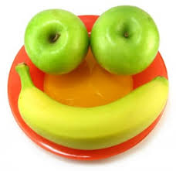
HEALTH AND WELL-BEING
They have a positive effect on children’s attitudes to food and healthy eating habits
Morris, JL and Zidenberg-Cherr, S. 2002. Garden-based nutrition curriculum improves fourth-grade school children’s knowledge of nutrition and preferences for some vegetables. Journal of the American Dietetic Association 102(1): 91-93.

Slide 15
ENVIRONMENTAL AWARENESS
They increase children’s awareness of the natural environment. Children can become “citizen scientists.”
A garden is an environment in miniature, and to be successful a gardener must work in sympathy with nature (Demas, 1979). Gardens ground children in growth and decay, predator–prey relations, pollination, carbon cycles, soil morphology, and microbial life: the simple and the complex simultaneously. Gardens are intensely local. Everything except possibly the purchased plants and seeds are part of the natural local environment. The clouds, rain, and sun, the seasonal cycle, the soil and its myriad organisms, the insects, arachnids, birds, reptiles, and mammals that visit the garden teach about place(Blair, 2009,p.17).
Blair, D. (2009). The Child in the Garden: An Evaluative Review of the Benefits of School Gardening. The Journal of Environmental Education. 40 (2) 15-38.
Arjen E. J. Wals , Brody, M. , Dillon, J , Stevenson, R.B. Convergence Between Science and Environmental Education (2014). Science, 344( 9)

Slide 16
CARING LEADS TO LOVE
In contrast to means-end reasoning, environmental responsibility emerges from caring involvements in gardening, farming, animal care, cooking, building and nature conservation. Within these activities children are likely to experience the interactions with their natural environment in a direct, bodily and sensory way. Postma & Smeyers(2012)

Slide 17
INTERDEPENDENCE IN THE GARDEN

Slide 18
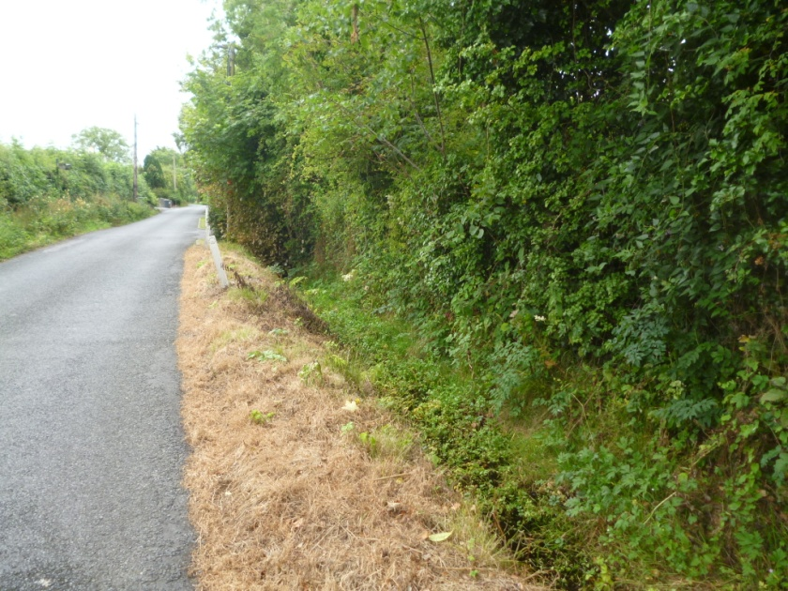
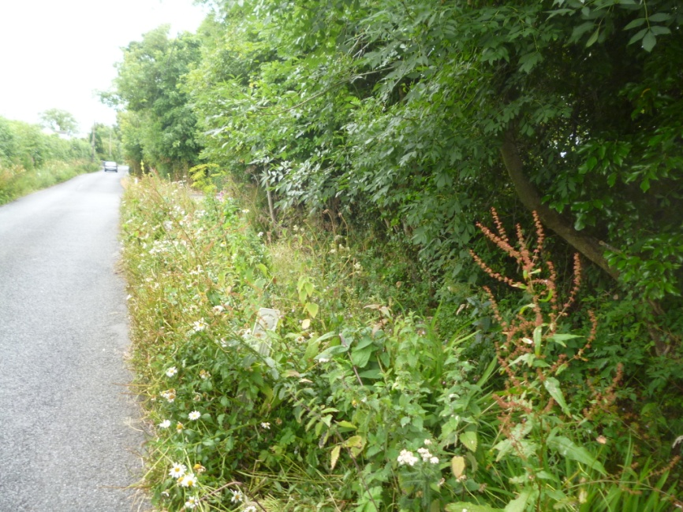
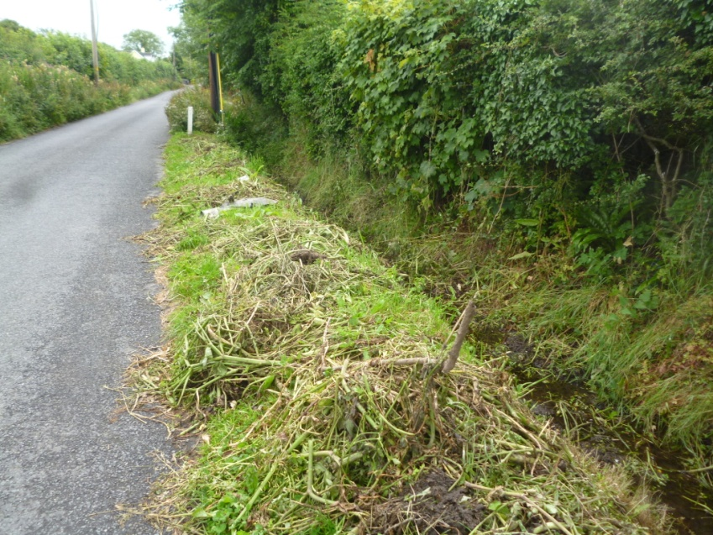
4 perspectives on nature on the same road-which is yours and which is best?

Slide 19
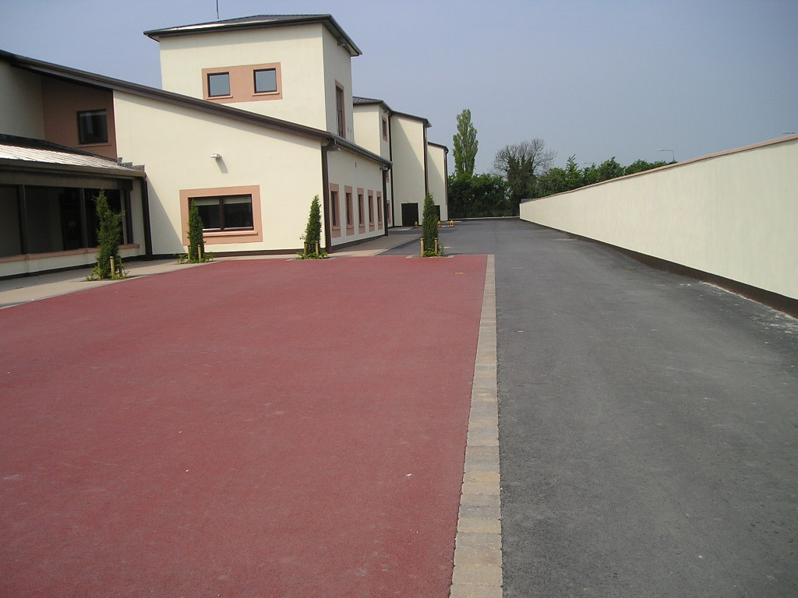
Which school garden has the most biodiversity?

Slide 20
ADHD
There is now a substantial body of research evidence that supports the idea that children’s behaviour generally as well as behavioural disorders, such as Attention Deficit Hyperactivity Disorder (ADHD), are improved when children are involved in activities outdoors. There is a 30 per cent improvement in the symptons of ADHD if these activities are in a green space, rather than in an urban site or playground. (Cutting, R. and Kelly, O. 2015, pp. 140,141)
Cutting, R. and Kelly, O. (2015). Creative Teaching in Primary Science. London: Sage Publications.

Slide 21
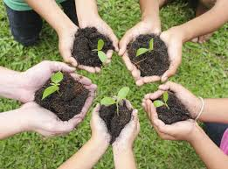
COMMUNITY CONNECTIVITY and COHESION
They help to develop a sense of community: pensioners; sales; tidy towns; parents
Passy, M, Morris, M, and Reed, F. (2010). Impact of school gardening on learning: Final report submitted to the Royal Horticultural Society.
Robinson, C. W., and Zajicek, J.M. (2005). Growing minds: the effects of a one year school garden program on six constructs of life skills of elementary school children. HortTechnology 15(3) 453-457.

Slide 22
THE OUTDOOR CLASSROOM
I really like it because you don’t have to, like, sit in class all the time and you’re doing stuff that you enjoy. ... it makes you feel refreshed and stuff, so you actually want to come back to school on Monday for another Friday. (Passey, R. et al, 2010, p.39.)

Slide 23
PRINCIPALS AND TEACHERS
The teacher and principal are major variables in school-garden success. In particular, more needs to be known about the principal’s effect. Major teacher issues are lack of personal interest and limited capabilities, knowledge, and time. (Blair, 2009,p.35)

Slide 24
ADVICE OF COMENIUS 1632!

Slide 25
REFERENCES
Arjen E. J. Wals , Brody, M. , Dillon, J , Stevenson, R.B. Convergence Between Science and Environmental Education (2014). Science, 344( 9)
Blair, D. (2009). The Child in the Garden: An Evaluative Review of the Benefits of School Gardening. The Journal of Environmental Education. 40 (2) 15-38.
Cutting, R. and Kelly, O. (2015). Creative Teaching in Primary Science. London: Sage Publications.
DeMarco, L., P. D. Relf, and A. McDaniel. 1999. Integrating gardening into the elementary school curriculum. HortTechnology 9(2):276-281.
Klemmer, C. D., T. M. Waliczek, and J. M. Zajicek. 2005. Growing minds: The effect of a school gardening program on the science achievement of elementary students. HortTechnology15(3):448-452
Passy , R. (2014) School gardens: teaching and learning outside the front door. Education 3-13: International Journal of Primary, Elementary and Early Years Education, 42 (1), 23-38, DOI: 10.1080/03004279.2011.636371
Passy, M, Morris, M, and Reed, F. (2010). Impact of school gardening on learning: Final report submitted to the Royal Horticultural Society.
Robinson, C. W., and Zajicek, J.M. (2005). Growing minds: the effects of a one year school garden program on six constructs of life skills of elementary school children. HortTechnology 15(3) 453-457.
Postma, D. & Smeyers , P. (2012) Like a swallow, moving forward in circles: on the future dimension of environmental care and education. Journal of Moral Education Vol. 41, No. 3, September 2012, pp. 399–412

